Slide 1

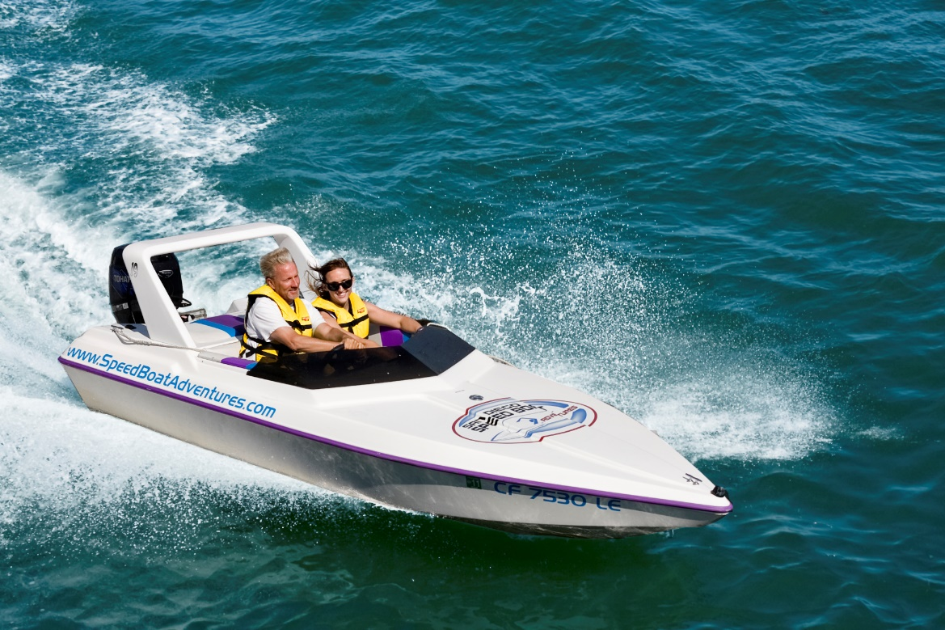
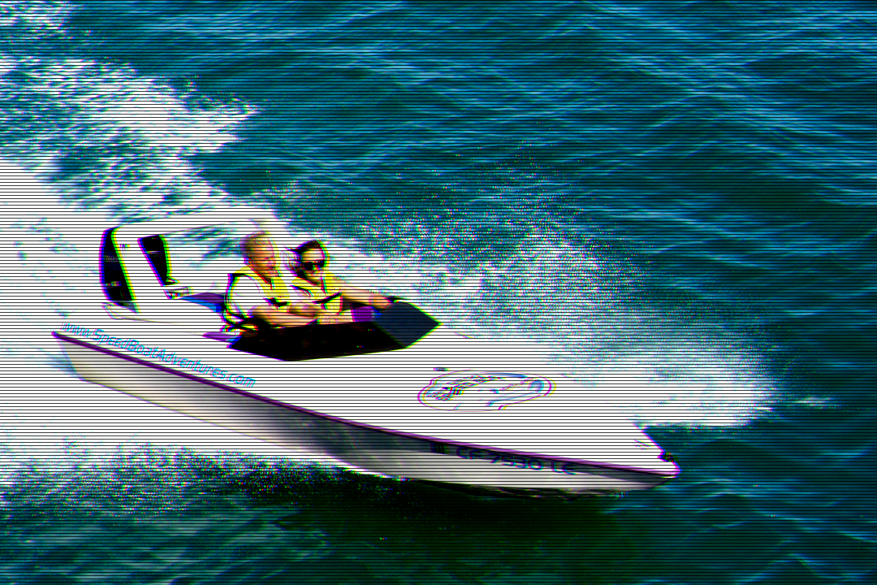
The Vintage TV Filter
This filter will take you back a couple decades by making your favorite image look like it is being displayed on a CRT TV.
There are three things it takes to do this:
1. Increase in contrast and brightness.
2. Add scanlines to resemble a CRT TV.
3. Push the green and blue colors out of phase with eachother.

